Slide 1
مدیریت پروژه های فناوری اطلاعات
دانشکده مهندسی کامپیوتر و فناوری اطلاعات
رشته مهندسی فناوری اطلاعات
دوره کارشناسی

Slide 2

Chapter 1: Introduction to Project Management
Information Technology Project Management, Seventh Edition
Note: See the text itself for full citations.

Slide 3
Program and Project Portfolio Management
A program is “a group of related projects managed in a coordinated way to obtain benefits and control not available from managing them individually” (PMBOK® Guide, Fifth Edition, 2012)
A program manager provides leadership and direction for the project managers heading the projects within the program
Examples of common programs in the IT field include infrastructure, applications development, and user support

Slide 4
Project Portfolio Management
As part of project portfolio management, organizations group and manage projects and programs as a portfolio of investments that contribute to the entire enterprise’s success
Portfolio managers help their organizations make wise investment decisions by helping to select and analyze projects from a strategic perspective

Slide 5
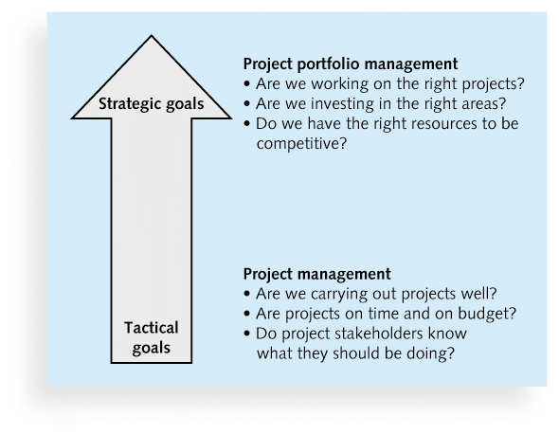
Figure 1-3. Project Management Compared to Project Portfolio Management

Slide 6
Best Practice
A best practice is “an optimal way recognized by industry to achieve a stated goal or objective”*
Robert Butrick suggests that organizations need to follow basic principles of project management, including these two mentioned earlier in this chapter:
Make sure your projects are driven by your strategy. Be able to demonstrate how each project you undertake fits your business strategy, and screen out unwanted projects as soon as possible
Engage your stakeholders. Ignoring stakeholders often leads to project failure. Be sure to engage stakeholders at all stages of a project, and encourage teamwork and commitment at all times
*Project Management Institute, Organizational Project Management Maturity Model
(OPM3) Knowledge Foundation (2003), p. 13.

Slide 7
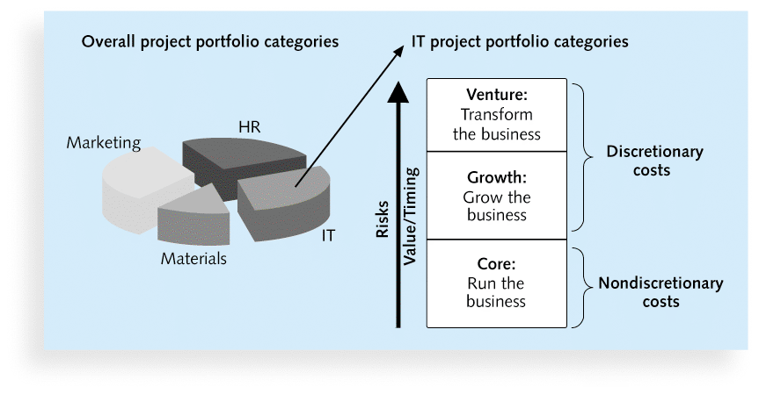
Figure 1-4. Sample Project Portfolio Approach

Slide 8
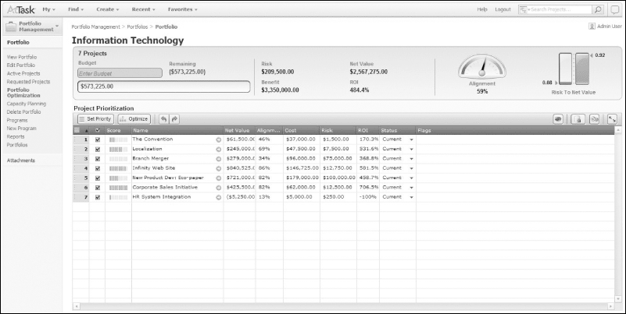
Figure 1-5. Sample Project Portfolio Management Screen Showing Portfolio Optimization

Slide 9
The Role of the Project Manager
Job descriptions vary, but most include responsibilities like planning, scheduling, coordinating, and working with people to achieve project goals
Remember that 97% of successful projects were led by experienced project managers, who can often help influence success factors

Slide 10
Suggested Skills for Project Managers
The Project Management Body of Knowledge
Application area knowledge, standards, and regulations
Project environment knowledge
General management knowledge and skills
Soft skills or human relations skills

Slide 11
Table 1-3 Ten Most Important Skills and Competencies for Project Managers
1. People skills
2. Leadership
3. Listening
4. Integrity, ethical behavior, consistent
5. Strong at building trust
6. Verbal communication
7. Strong at building teams
8. Conflict resolution, conflict management
9. Critical thinking, problem solving
10. Understands, balances priorities

Slide 12
Different Skills Needed in Different Situations
Large projects: Leadership, relevant prior experience, planning, people skills, verbal communication, and team-building skills were most important
High uncertainty projects: Risk management, expectation management, leadership, people skills, and planning skills were most important
Very novel projects: Leadership, people skills, having vision and goals, self confidence, expectations management, and listening skills were most important

Slide 13
Importance of Leadership Skills
Effective project managers provide leadership by example
A leader focuses on long-term goals and big-picture objectives while inspiring people to reach those goals
A manager deals with the day-to-day details of meeting specific goals
Project managers often take on the role of both leader and manager

Slide 14
Careers for IT Project Managers
In a 2011 survey, IT executives listed the “nine hottest skills” they planned to hire for in 2012
Project management was second only to programming and application development

Slide 15
Table 1-4. Nine Hottest Skills*
Skill |  | Percentage of Respondents
Programming and application development |  |  | 60%
Project management |  |  | 44%
Help desk/technical support |  |  | 35%
Networking |  |  | 35%
Business intelligence |  |  | 23%
Data center |  |  | 18%
Web 2.0 |  |  | 18%
Security |  |  | 17%
Telecommunications |  |  | 9%
*Source: Rick Saia, “9 Hot IT Skills for 2012,”
Computerworld, September 26, 2011.

Slide 16
The Project Management Profession
The profession of project management is growing at a very rapid pace
It is helpful to understand the history of the field, the role of professional societies like the Project Management Institute, and the growth in project management software

Slide 17
History of Project Management
Some people argue that building the Egyptian pyramids was a project, as was building the Great Wall of China
Most people consider the Manhattan Project to be the first project to use “modern” project management
This three-year, $2 billion (in 1946 dollars) project had a separate project manager and a technical manager

Slide 18
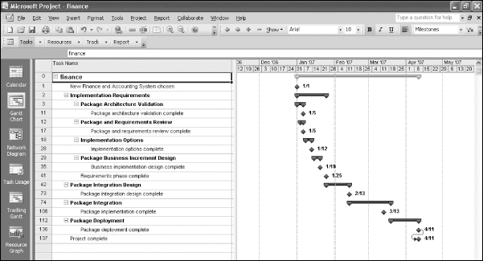
Figure 1-6. Sample Gantt Chart Created with Project 2010

Slide 19
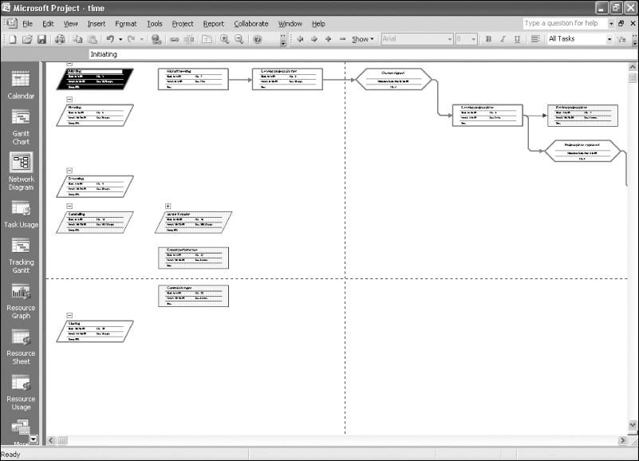
Figure 1-7. Sample Network Diagram Created with Project 2010

Slide 20
Project Management Offices
In the 100s, many companies began creating PMOs to help them handle the increasing number and complexity of projects
A Project Management Office (PMO) is an organizational group responsible for coordinating the project management function throughout an organization

Slide 21
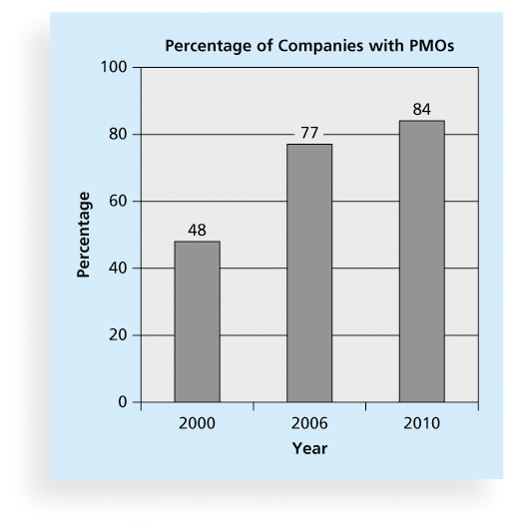
Figure 1-8. Growth in the Number of Project Management Offices

Slide 22
Global Issues
Several global dynamics are forcing organizations to rethink their practices:
Talent development for project and program managers is a top concern
Good project portfolio management is crucial in tight economic conditions
Basic project management techniques are core competencies
Organizations want to use more agile approaches to project management
Benefits realization of projects is a key metric

Slide 23
The Project Management Institute
The Project Management Institute (PMI) is an international professional society for project managers founded in 1969
PMI has continued to attract and retain members, reporting more than 380,000 members worldwide by 2012
There are communities of practices in many areas, like information systems, financial services, and health care
Project management research and certification programs continue to grow
Students can join PMI at a reduced fee and earn the Certified Associate in Project Management (CAPM) certification(see www.pmi.org for details)

Slide 24
Project Management Certification
PMI provides certification as a Project Management Professional (PMP)
A PMP has documented sufficient project experience, agreed to follow a code of ethics, and passed the PMP exam
The number of people earning PMP certification is increasing quickly
PMI and other organizations offer additional certification programs (see Appendix B)

Slide 25
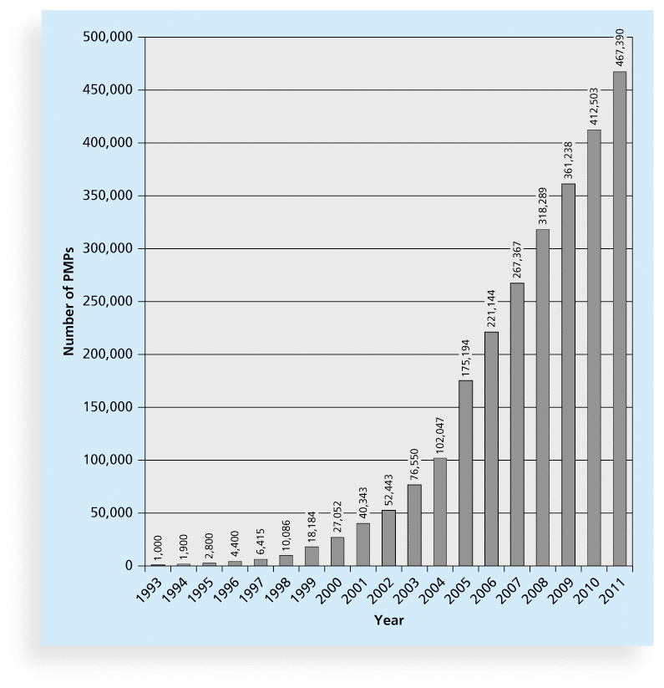
Figure 1-9 Growth in PMP Certification, 1993-2011

Slide 26
Ethics in Project Management
Ethics, loosely defined, is a set of principles that guide our decision making based on personal values of what is “right” and “wrong”
Project managers often face ethical dilemmas
In order to earn PMP certification, applicants must agree to PMI’s Code of Ethics and Professional Conduct
Several questions on the PMP exam are related to professional responsibility, including ethics

Slide 27
Project Management Software
There are hundreds of different products to assist in performing project management
Three main categories of tools:
Low-end tools: Handle single or smaller projects well, cost under $200 per user
Midrange tools: Handle multiple projects and users, cost $200-$1,000 per user, Project 2010 most popular
High-end tools: Also called enterprise project management software, often licensed on a per-user basis, like Microsoft Enterprise Project Management solution

Slide 28
Chapter Summary
A project is a temporary endeavor undertaken to create a unique product, service, or result
Project management is the application of knowledge, skills, tools, and techniques to project activities to meet project requirements
A program is a group of related projects managed in a coordinated way
Project portfolio management involves organizing and managing projects and programs as a portfolio of investments
Project managers play a key role in helping projects and organizations succeed
The project management profession continues to grow and mature

Slide 29
Chapter 2: The Project Management and Information Technology Context
Information Technology Project Management, Seventh Edition
Note: See the text itself for full citations.

Slide 30
Projects Cannot Be Run In Isolation
Projects must operate in a broad organizational environment
Project managers need to use systems thinking:
taking a holistic view of carrying out projects within the context of the organization
Senior managers must make sure projects continue to support current business needs

Slide 31
A Systems View of Project Management
A systems approach emerged in the 1950s to describe a more analytical approach to management and problem solving
Three parts include:
Systems philosophy: an overall model for thinking about things as systems
Systems analysis: problem-solving approach
Systems management: address business, technological, and organizational issues before making changes to systems

Slide 32
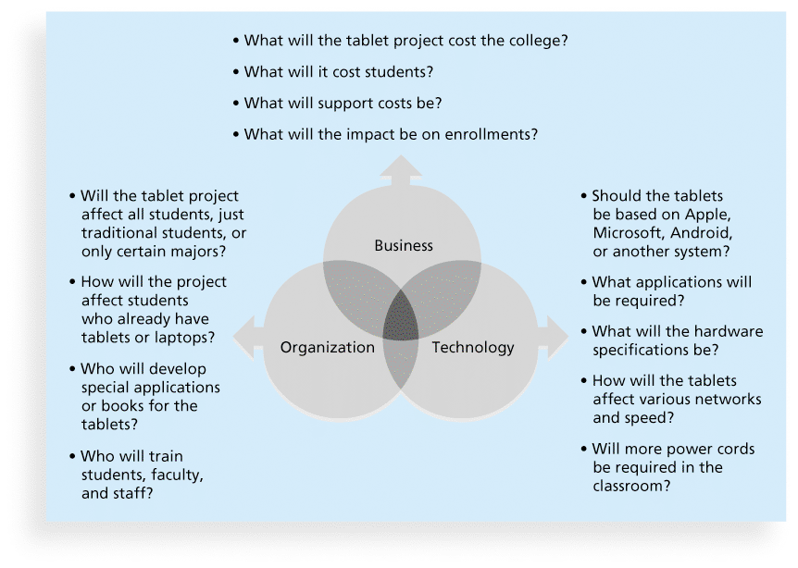
Figure 2-1. Three Sphere Model for Systems Management

Slide 33
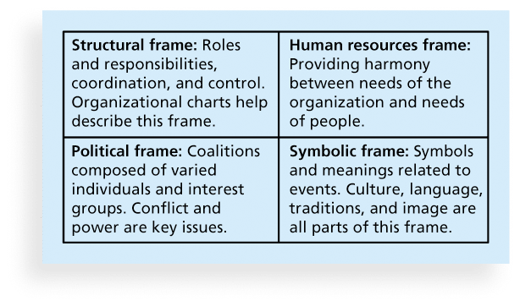
Figure 2-2. Perspectives on Organizations

Slide 34
What Went Wrong?
In a paper titled “A Study in Project Failure,” two researchers examined the success and failure of 214 IT projects over an eight-year period in several European countries.
The researchers found that only one in eight (12.5 percent) were considered successful in terms of meeting scope, time, and cost goals.
The authors said that the culture within many organizations is often to blame
Among other things, people often do not discuss important leadership, stakeholder, and risk management issues

Slide 35
Organizational Structures
3 basic organization structures
Functional: functional managers report to the CEO
Project: program managers report to the CEO
Matrix: middle ground between functional and project structures; personnel often report to two or more bosses; structure can be weak, balanced, or strong matrix

Slide 36
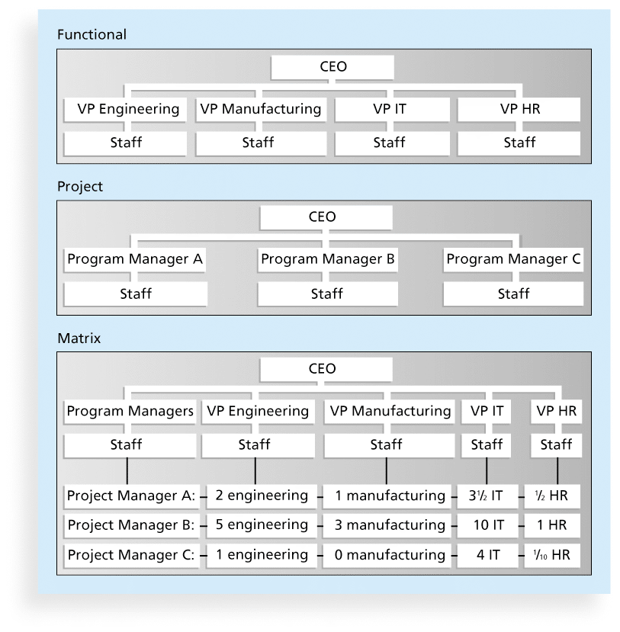
Figure 2-3. Functional, Project, and Matrix Organizational Structures

Slide 37
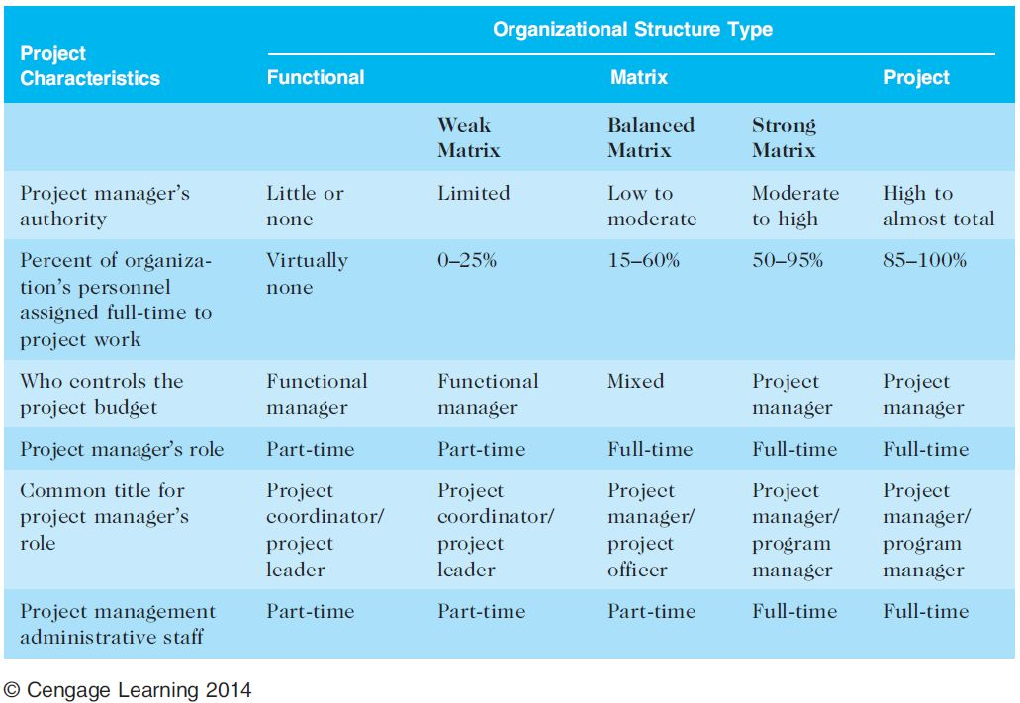
Table 2-1. Organizational Structure Influences on Projects

